Slide 1
Community-Participatory and Youth Participatory Approaches to Students Support Services: Advancing Sustainable Change in Schools
Alberti Conference 2026
Katheryne T. Leigh-Osroosh, PhD

Slide 2
Schedule
1:00-1:45pm (Part 1)
15 min break
2:00-2:45pm (Part 2)

Slide 3
Learning Outcomes
Explain
Explain how community and youth participatory research approaches can be used to address achievement and wellness gaps.
Practice
Practice activities to include students and community stakeholders in creating sustainable culturally-relevant change.
Describe
Describe how they will incorporate participatory practices within their schools to foster safer and more inclusive environments.

Slide 4
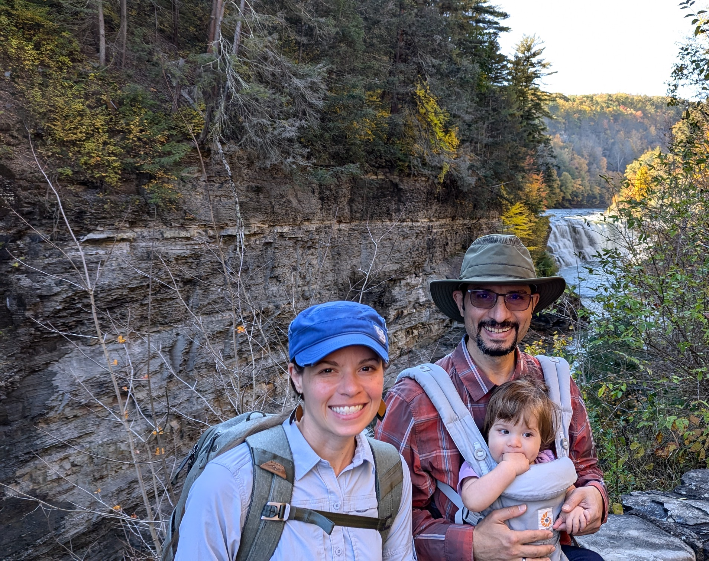
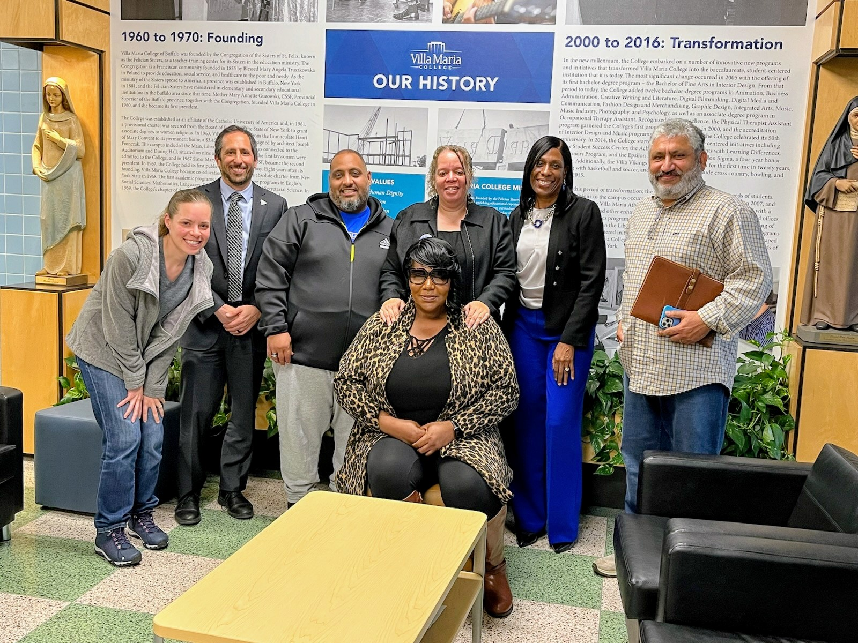
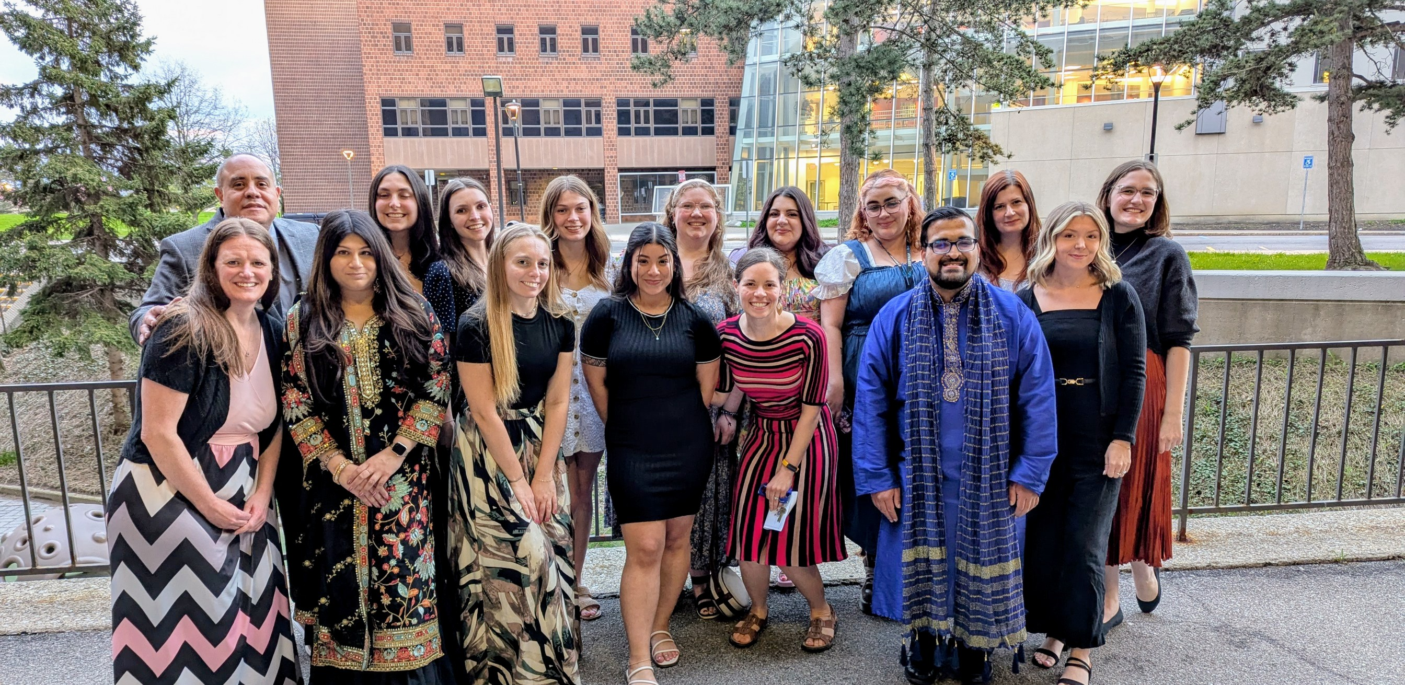
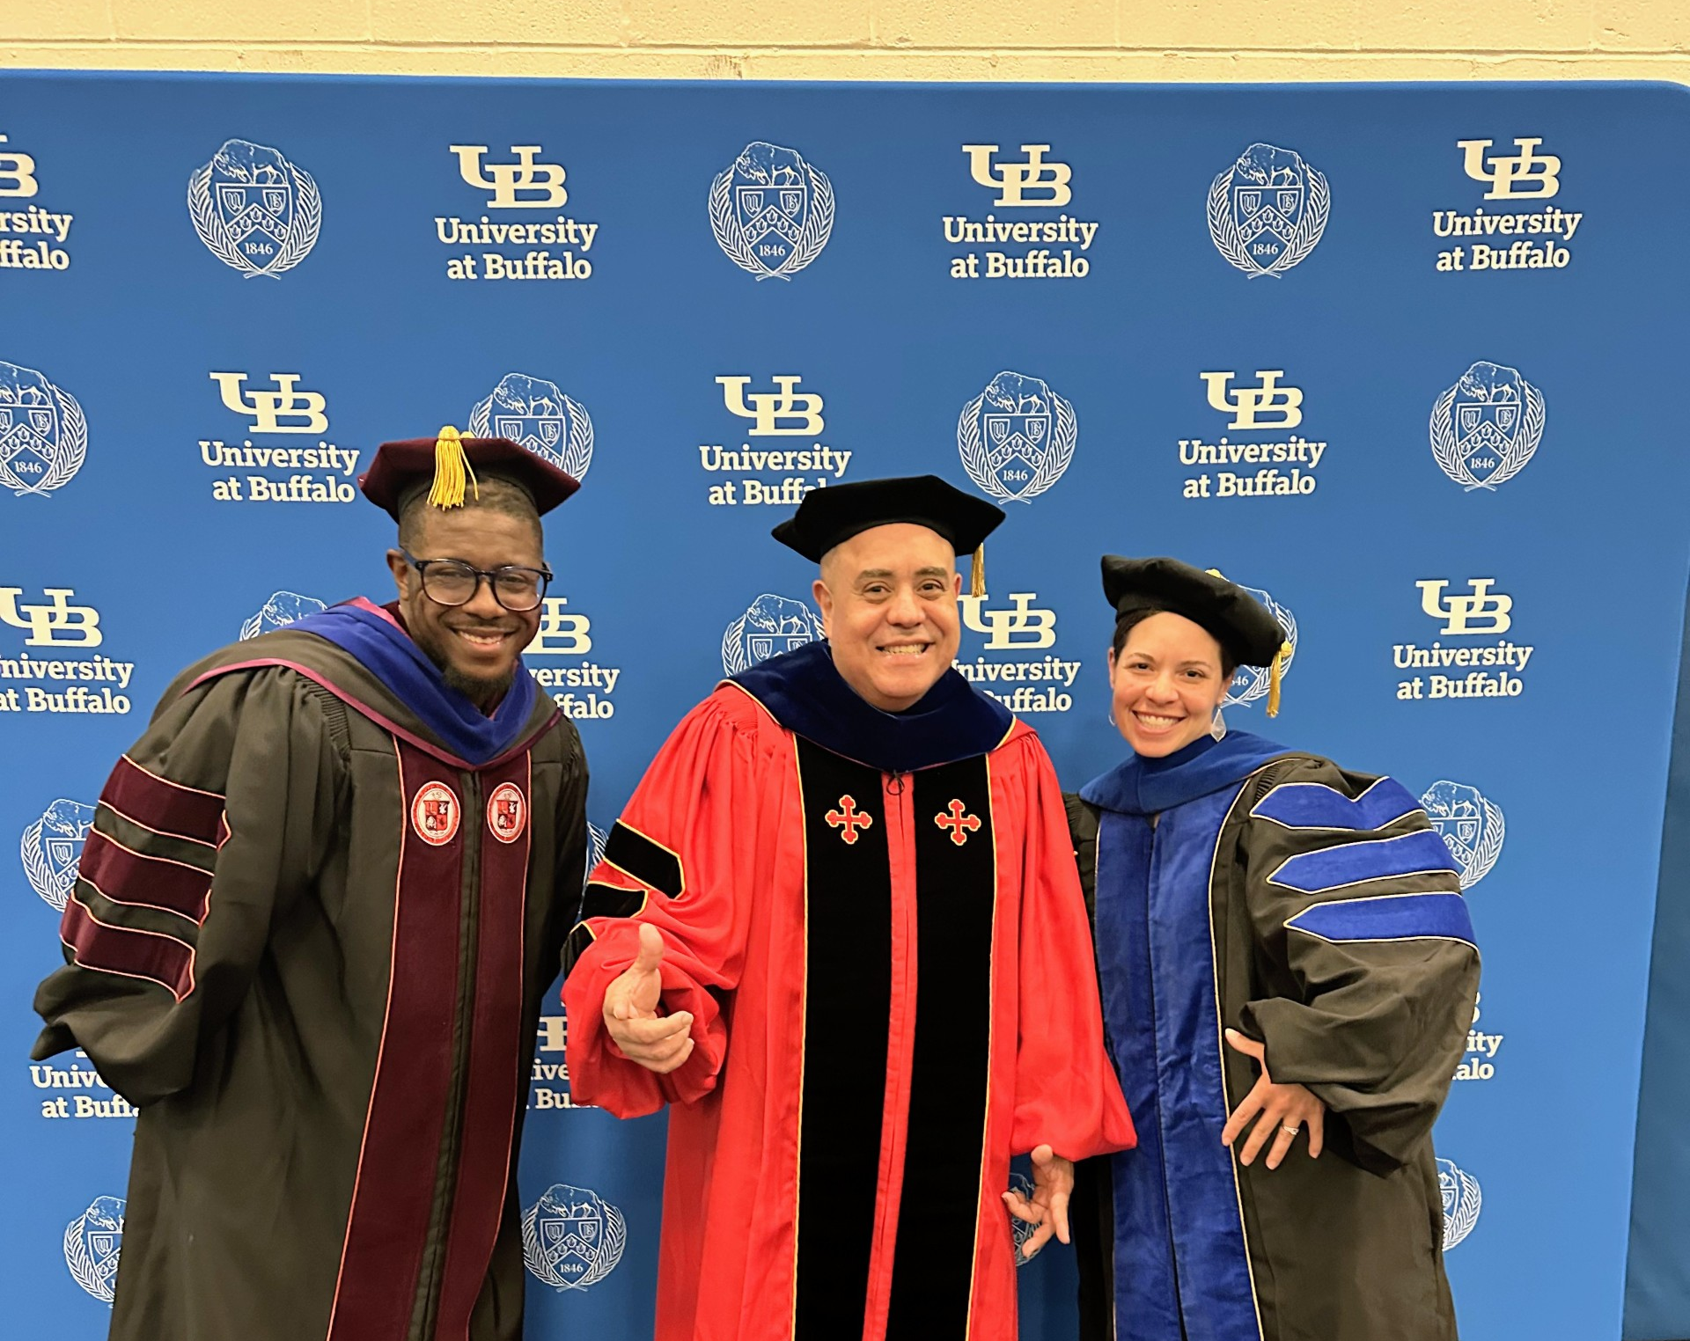
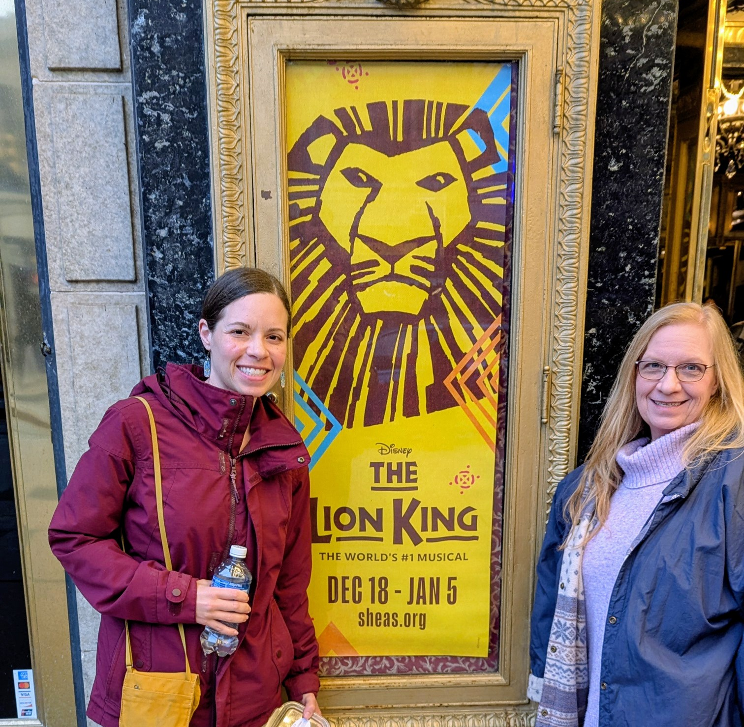
Introduction
PhD Counselor Education
2 yrs Elementary school counselor
Notes:
NYS bar association convocation on civics education

Slide 5
Getting to know each other…
What keeps you up at night?
What are you most proud of?

Slide 6

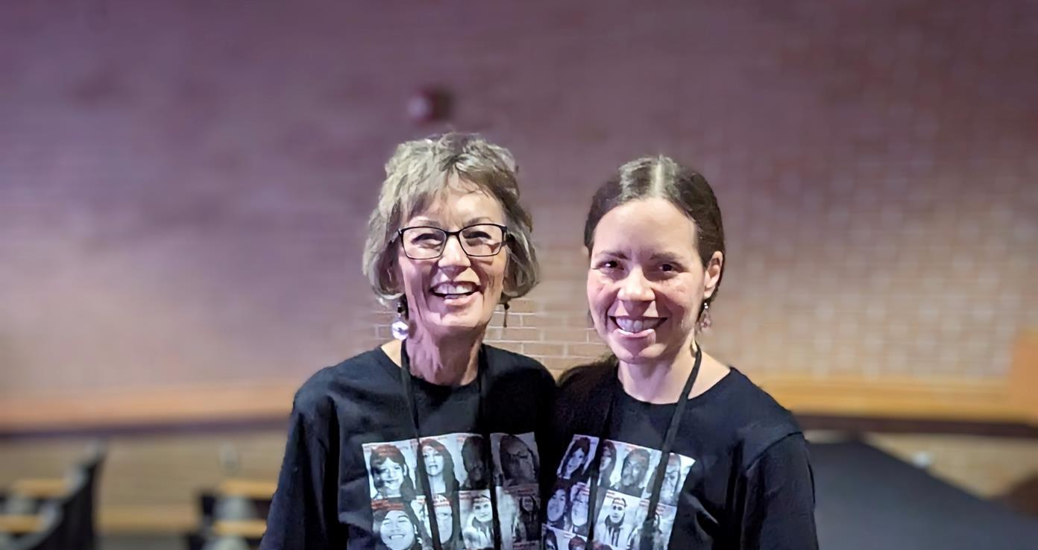
My response

Slide 7
Relevance of Existential Themes
Existential angst & four ultimate concerns (death, isolation, meaninglessness, freedom)
  Where do you see these arise in youth and the community today?
  What is creating barriers for clients to cope with these ultimate concerns?
  What barriers do helpers/caregiving professionals face when providing care to clients?
  How can we empower clients? How can we empower ourselves?

Slide 8
Threats and Limitations to Evidence-based practices
Merit & Worth
Resources
Legal fights/threats to mental health professions

Slide 9
Need to repair & engage in relationships with community
Translational research
Capacity building
Empowering, sustainable, political action
Human centered

Slide 10
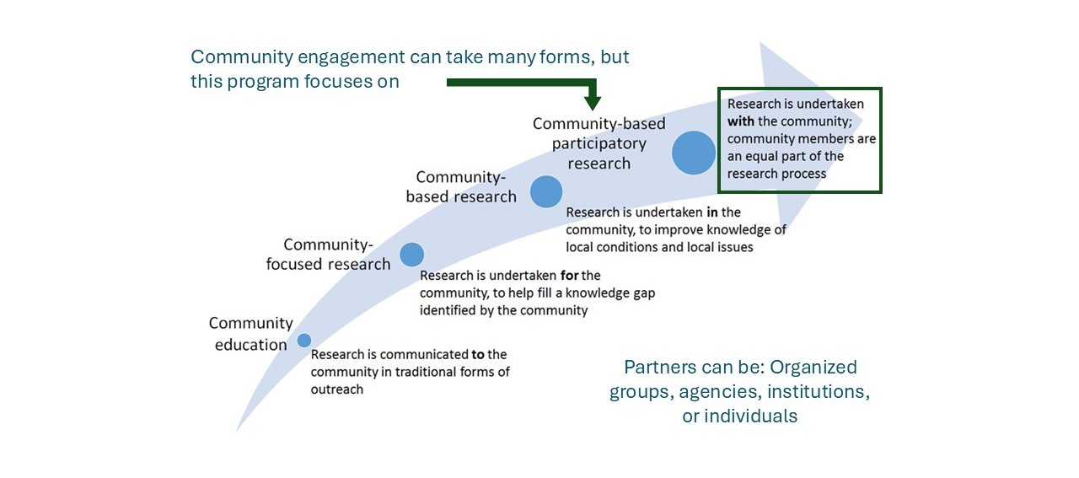
Community Engaged Research

Slide 11
CBPAR and YPAR Defined
Community Based Participatory Research (CBPR) is an emancipatory approach to research that works with community members versus for or on community (Wallerstein, Duran, Oetzel, & Minkler, 2018).
Youth Participatory Action Research (YPAR) expands upon action research with the inclusion of youth in the process from identifying the root cause through to the evaluation of the outcomes of the interventions.

Slide 12
Principles of CBPR & YPAR (Israel et al., 1998)
Recognizes community as unit of identity
Builds on strengths and resources within community
Facilitates collaborative partnerships in all phases of the project
Integrates knowledge and action for mutual benefit of all partners
Promotes a co-learning and empowering process that attends to social inequalities
Involves a cyclical and iterative process
Addresses health from both positive and ecological perspectives
Disseminates findings and knowledge gained to all partners

Slide 13
Higher Order Constructs
Capacity: examined within contexts includes community history, bridging social capital, and partnership capacity
Collective empowerment: within the partnership process includes collective reflection/reflexivity, community fit, shared CBPR principles, influence/agency
Relationships: within partnership processes includes leadership, conflict resolution, participation, and trust
Community involvement in research: within intervention and research design, interpretation and dissemination, community action

Slide 14
Outcomes
Collective empowerment & self-efficacy development
Shared power relations
Sustainability
Skill and knowledge development
Critical consciousness/awareness
Policy, research, health, and social systemic change

Slide 15
Community Engaged Counseling Research
Scope review (2010-2023)
4521 articles from 17 ACA journals & ASCA, 65 met inclusion criteria
Clinical mental health (n=23), school counseling (n=15), & counseling psychology (n=13)
Majority were PAR studies (n=12) and photovoice (n=11)
Outcomes:
  Art exhibit
  Publication
  Community presentation
  Sustain community programming & policy change (N=8)

Slide 16
Why CBPR and YPAR in the counseling fields?
Community-engaged approaches are social justice-oriented and require a commitment to sustainable, systemic change.
Opportunity for us to get back to our roots of community counseling and educate counselors-in-training about how they can incorporate tenets of community-engaged practice in their work.
Opportunity for counselors to move beyond institutions that uphold systemic barriers, invest in communities, and demonstrate that we are social justice advocates

Slide 17
15 min Break

Slide 18
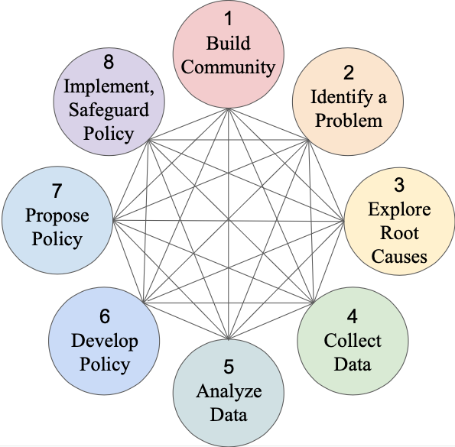
Youth Participatory Action Research

Slide 19

Dream school scenario
What would your dream school look like?
What sounds would you hear?
What would you feel like walking through the hallways?
What would you be doing differently?
What barriers prevent this dream school from happening?

Slide 20
Root Cause Analysis
Identify the problem
Collect data
Identify possible causal factors
Identify root causes
Recommend interventions and solutions

Slide 21
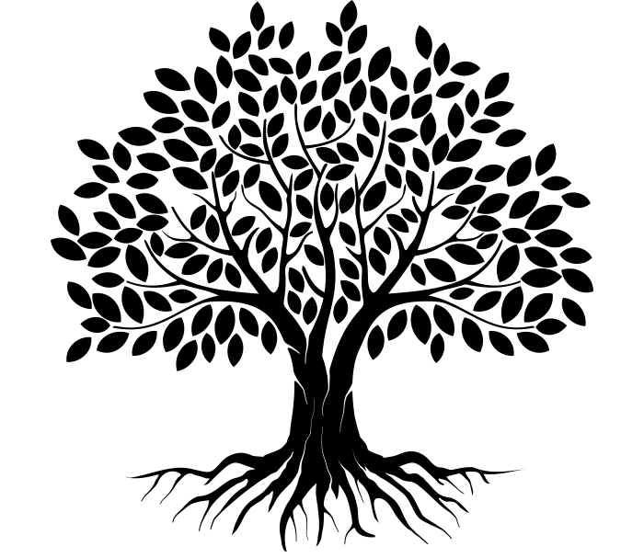
Leaves = Symptoms (showing up in life)
Limbs = factors leading those symptoms (experiences or situations)
Roots = events or policies contributing to limbs (social-historical)
Trunk = Problem
Created by ka reemov from Noun Project
Transformative Student Voice Research Group

Slide 22
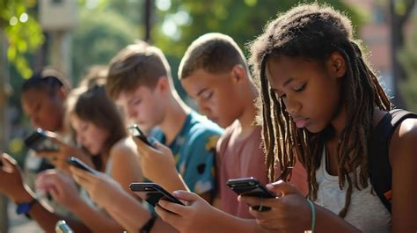

Code with SHOWED questions (Wang & Burris, 1997)
What do you see?
What’s really happening? How might people be feeling?
How does this case relate to your lived experience?
Why does this problem(s) occur?
What would help empower us?
What can we do about the problem?

Slide 23
Data-driven Intervention development and Implementation
Merit (meaningful to the group directly involved) and worth (meaningful to the community at large)
Start with anticipated outcomes (long and intermediate) then work backwards through outputs and processes ending with partnership process and contexts
Created with an understanding of capacity and resources of community community
This step may not be included in YPAR because the YPAR process is the intervention which leads to policy creation

Slide 24
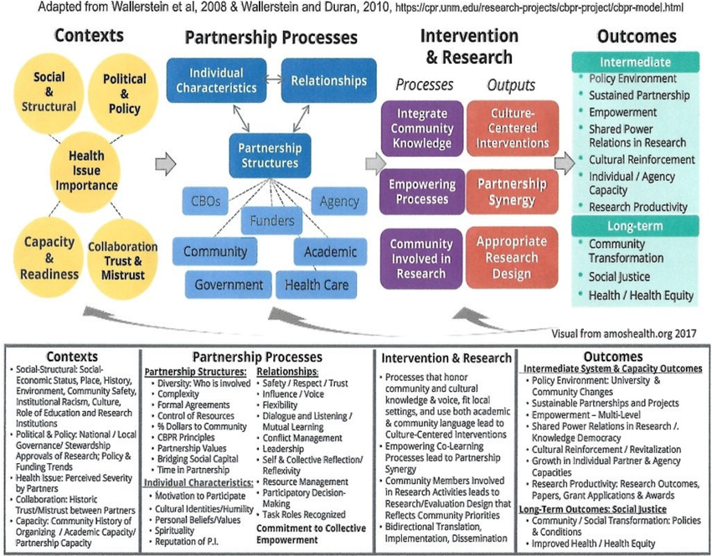
Vision/Logic model (Wallerstein et al., 2018)

Slide 25
Data Collection & Analysis/Program Evaluation
Focus groups & individual interviews
Needs assessment
Photovoice or community art project
Observations
Surveys
Choice of Qualitative, Quantitative, and Mixed methods designs
Analysis includes community members
Process is cyclical & iterative meaning that data is collected and examined during implementation, project is then refined based on findings

Slide 26
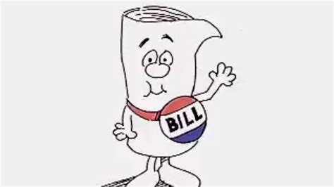
Policy Formation & Power Map
Don’t need to be legal expert but need to learn the process of policy creation and how it becomes adopted school board, licensing board, local government, etc.
Need to understand who are the folks with power to make change and those with the potential to influence situation and if they support, neutral, or oppose your new policy

Slide 27
Power Map
Supporters
Neutral or Can’t Comment
Opposition
Targets with power to make change
Ppl affected by policy/problem or have potential to influence situation

Slide 28
Dissemination/Propose Policy
Consider the power map when deciding on audience
Accessibility
Freedom of expression/creativity
Inclusive of all co-researchers
Plan next steps

Slide 29
Groups in WNY & Nationally
Community Health Worker Network of Buffalo (CHW)
Collaborative Center for Social Innovation
Action Research Network of the Americas (ARNA)
The Collaborative Action Research Network (CARN)

Slide 30
Reflections & Questions

Slide 31
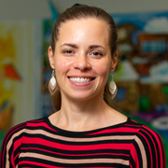
Questions?
How to contact me:
  LinkedIn
  Email: kosroosh@buffalo.edu
Presentation Citation:
Leigh-Osroosh, K.T. (2026, October). Community-Participatory and Youth Participatory Approaches to Students Support Services: Advancing Sustainable Change in Schools [Keynote Presentation]. Alberti Center for Bullying and Abuse Prevention, Buffalo, NY.

Slide 32
References
Clinical and Translational Science Awards Consortium, Community Engagement Key Function Committee., Task Force on the Principles of Community Engagement. (2011). Principles of community engagement. https://stacks.cdc.gov/view/cdc/11699
Israel, B. A., Schulz, A. J., Parker, E. A., & Becker, A. B. (1998). Review of community-based research: Assessing partnership approaches to improve public health. Annual Review of Public Health, 19(1), 173–202. https://doi.org/10.1146/annurev.publhealth.19.1.173
Stickney, D., Kirshner, B., Hipolito-Delgado, C. P., & Zion, S. (2025). Transformative student voice for teachers : a guide to classroom action. Harvard Education Press.
Wallerstein, N., Duran, B., Oetzel, J. G., & Minkler, M. (Eds.). (2018). Community-based participatory research for health: advancing social and health equity (Third edition.). Jossey-Bass, a Wiley Brand.
Wallerstein, N., Oetzel, J. G., Sanchez-Youngman, S., Boursaw, B., Dickson, E., Kastelic, S., Koegel, P., Lucero, J. E., Magarati, M., Ortiz, K., Parker, M., Peña, J., Richmond, A., & Duran, B. (2020). Engage for Equity: A Long-Term Study of Community-Based Participatory Research and Community-Engaged Research Practices and Outcomes. Health Education & Behavior, 47(3), 380–390. https://doi.org/10.1177/1090198119897075
Wang, C. C. (2006). Youth participation in photovoice as a strategy for community change. Journal of Community Practice, 14 (1–​2), 147–​16

